Slide 1
A comparison of Li-ion cells and supercapacitors in the efficiency of a regenerative braking system for EVs
By: Mateo Ceballos Querol
100448597
H600 (Hons) BEng Electrical and Electronic Engineering
Supervisor : David Wilson

Slide 2
Outline
Introduction
Aims
Motivation
Initial ideas
Conceptual flowchart
Design
Schematic
PCB
Prototype
Coding flowchart
Results & Analysis
Graphs
Sustainability & Ethics
Future recommendations
Conclusions
References

Slide 3
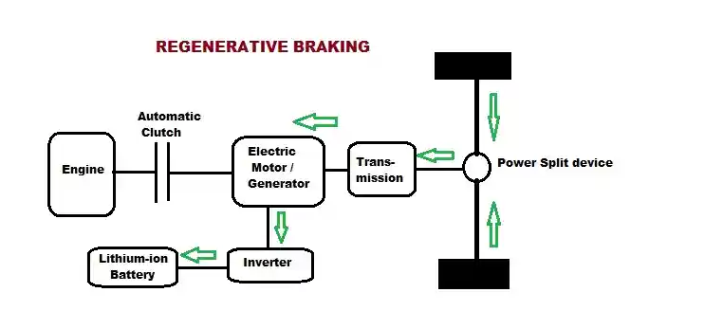
Introduction
Rise of EVs
Regenerative braking system
Concerns of battery technology
Environmental and ethical issues
Create prototype
(Smith, 2014)

Slide 4
Aims
Design and build a regenerative braking system using a DC motor.
Measure how much power is regained into each “battery pack” from the DC motor.
Provide a more ethically and environmentally sustainable means of manufacturing batteries.
Justify the potential change from LI-ion to supercapacitors as the potential power source for EVs.

Slide 5
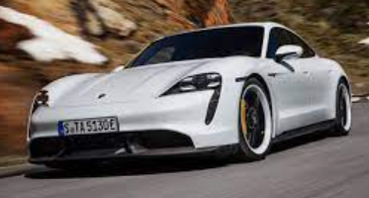

Motivation
Science & Tech
Electric Vehicles
Sustainability
Future interest in embedded systems
(Miller, 2019)
(Stuart, 2018)

Slide 6
Initial ideas
Plan A: Create compact enclosure/PCB
Develop regenerative braking system as in an EV
Send data to a PC via USB
Plan B: Simulink model, more freedom

Slide 7
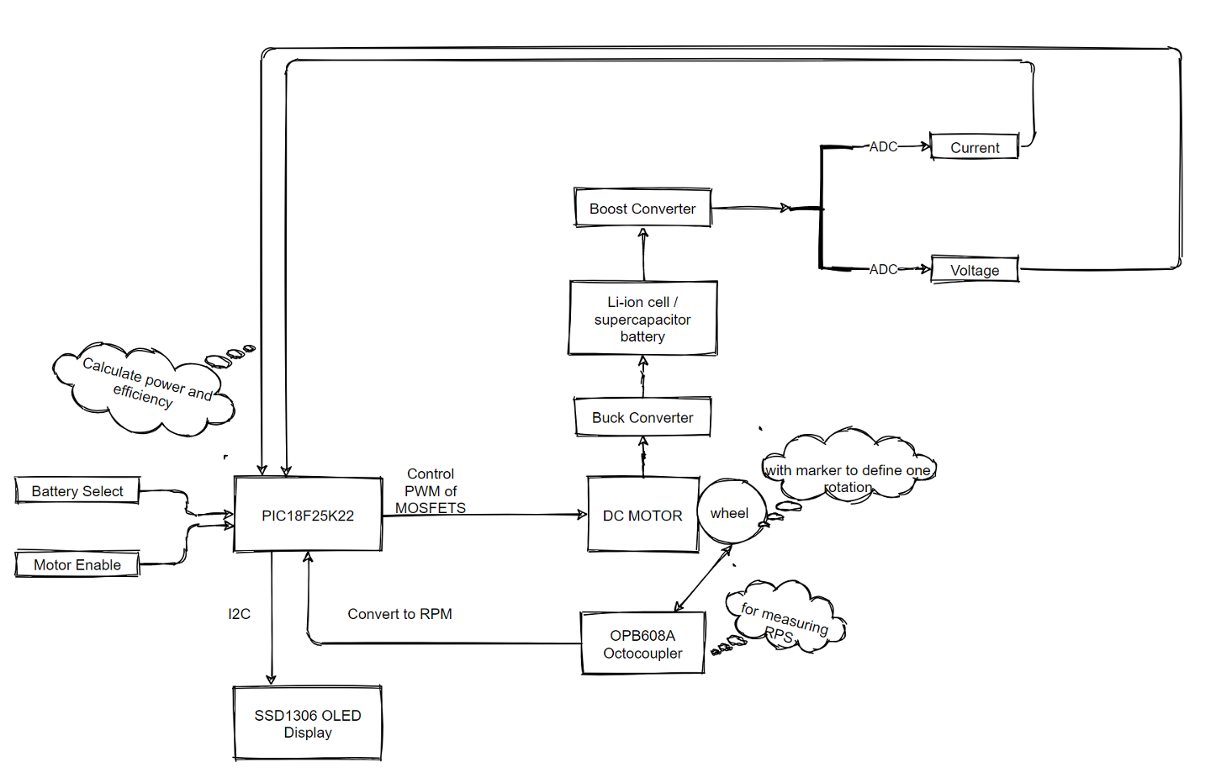
Conceptual flowchart

Slide 8
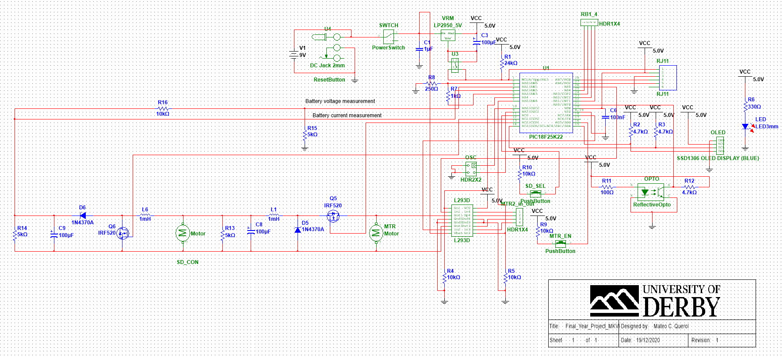
Design - Schematic
PIC18F25K22
Motor control
ADC
I2C
Optocoupler

Slide 9
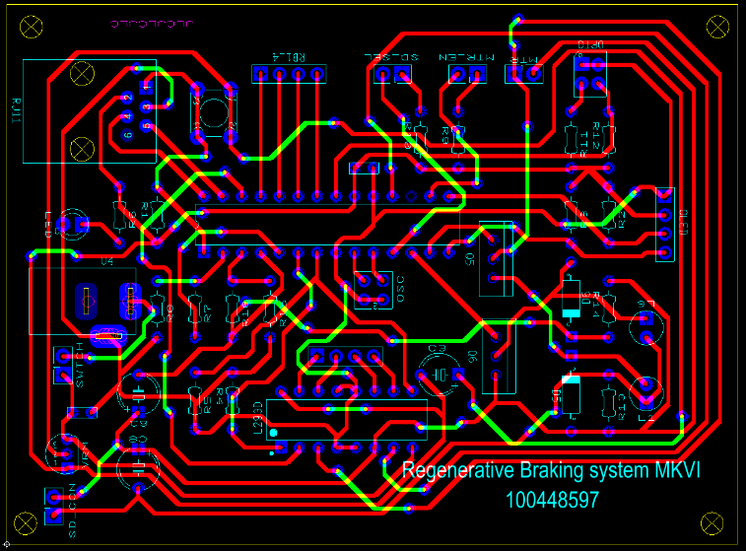
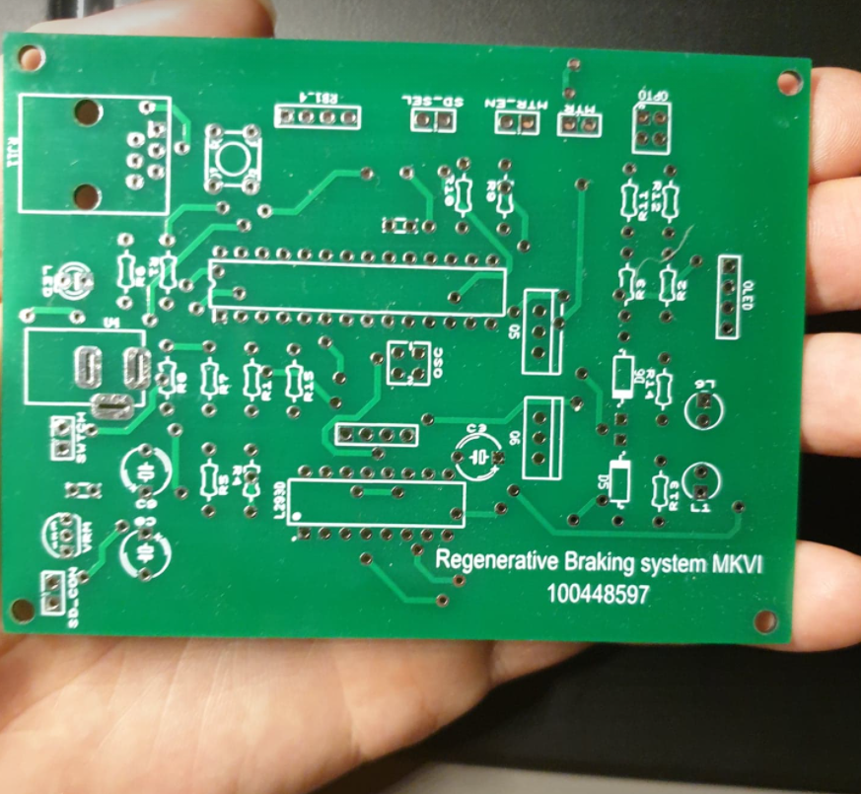
Design - PCB
Arduino-inspired design
6 iterations
JLCPCB

Slide 10
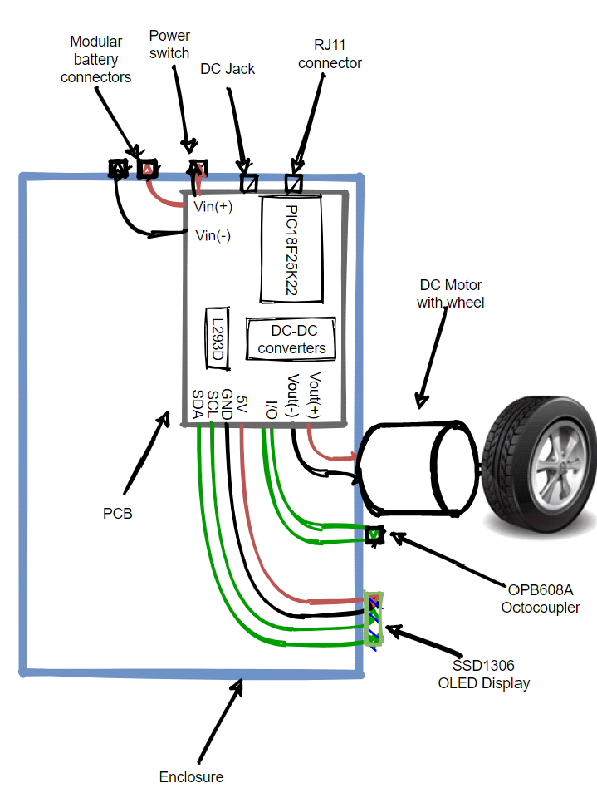
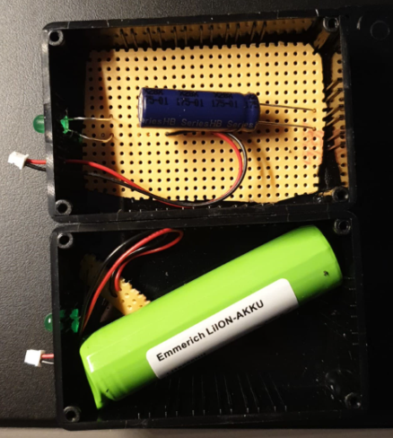
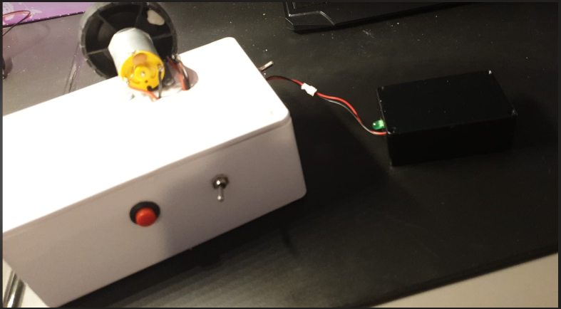
Design - Prototype
Modular design
Li-ion and supercapacitor
Main system
Storage device

Slide 11
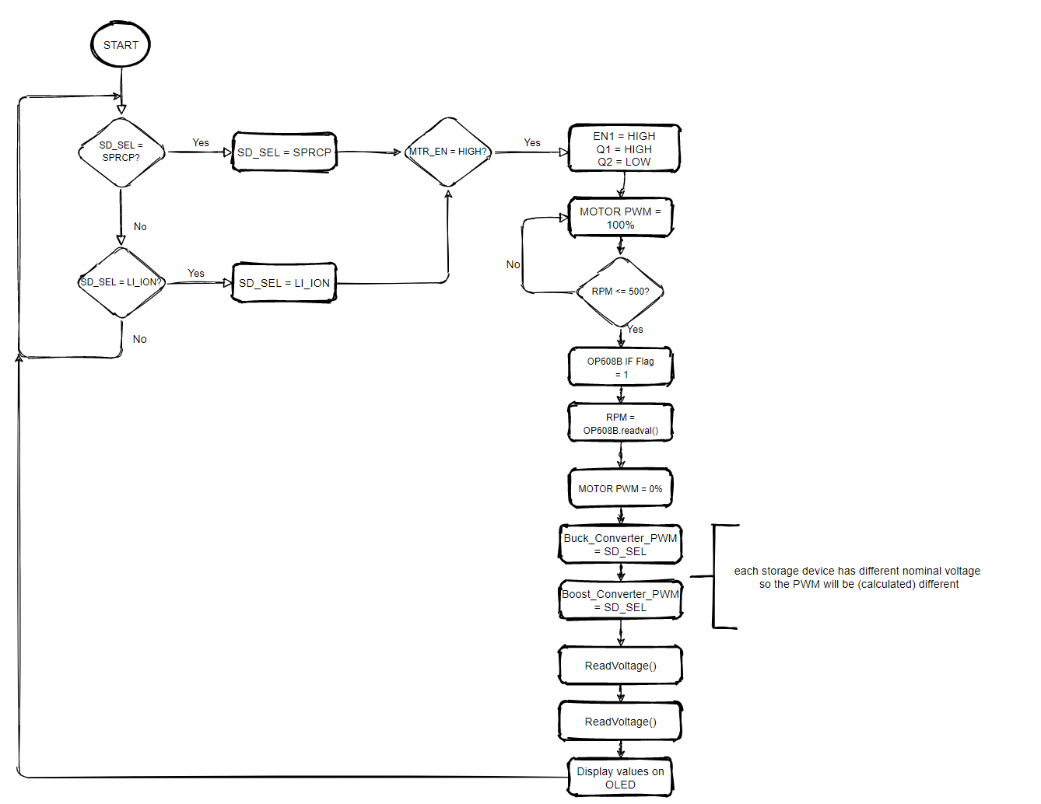
Coding flowchart

Slide 12
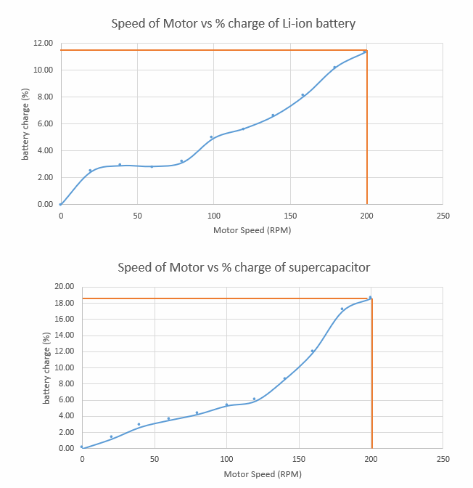
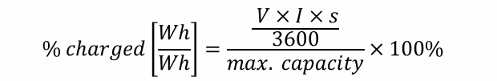
Results & Analysis - Graphs
Li-ion capacity : 8.14Wh
Supercapacitor capacity : 8.17mWh

Slide 13
Results & Analysis - Graphs
Max motor speed is 210 RPM
Max motor power is approx. 1.6W

Slide 14

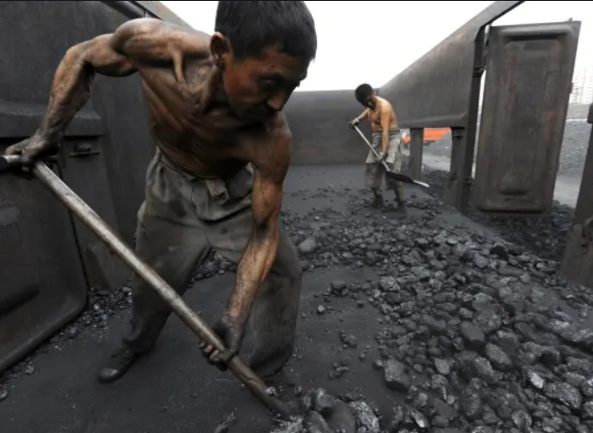
Results & Analysis – Sustainability & ethics
Mine leaks
Underpaid, non-safe working conditions
Import/Export
EU, circular economy
(Song, 2016)
(Hornby, 2020)

Slide 15
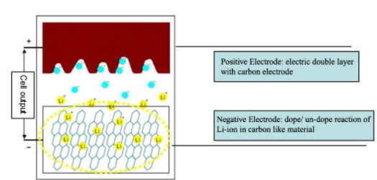
Future recommendations
SMD components
Larger Motor
Equal storage device capacities
Possible hybrid Li-ion-supercapacitor battery
(Keenan, 2017)

Slide 16
Conclusion
Total cost of project = £60.25
Environmental footprint
Li-ion batteries are still optimal
Increase in EV popularity

Slide 17
References
Emmerich. (2017). 18650 Li ion cell. https://asset.conrad.com/media10/add/160267/c1/-/en/000251007DS01/datasheet-251007-emmerich-icr-18650nh-sp-non-standard-battery-rechargeable-18650-cable-li-ion-37-v-2200-mah.pdf
fleeteurope. (2018). How ethically is lithium sourced by OEMs? | Fleet Europe. https://www.fleeteurope.com/fr/connected-financial-models/global-europe/analysis/how-ethically-lithium-sourced-oems?a=DQU04&t%5B0%5D=Electrification&t%5B1%5D=Volkswagen&t%5B2%5D=Lithium ion battery&curl=1
Garcia, G. (2014). (3) (PDF) Potential environmental impacts of Li-ion batteries and supercapacitors: Toxicity of carbon nanotubes. https://www.researchgate.net/publication/264081052_Potential_environmental_impacts_of_Li-ion_batteries_and_supercapacitors_Toxicity_of_carbon_nanotubes
HBSupercapacitors. (2018). Supercapacitor. http://www.farnell.com/datasheets/2849566.pdf
Keenan, M. (2017). Supercapacitor And Li-Ion Technology Combining | Avnet Abacus. https://www.avnet.com/wps/portal/abacus/resources/article/hybrid-capacitors-combine-supercacitor-and-li-on-technology/
Liu, Z. (2019). Lithium Ion Battery - History - Accelerating Microscopy. Zhao Liu. https://www.thermofisher.com/blog/microscopy/the-history-of-the-lithium-ion-battery/
Meyer, S. (2019). Child labour, toxic leaks: the price we could pay for a greener future | Green economy | The Guardian. https://www.theguardian.com/environment/2021/jan/03/child-labour-toxic-leaks-the-price-we-could-pay-for-a-greener-future

Slide 18
Thank you!
Questions?

